Slide 1
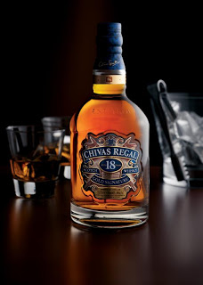
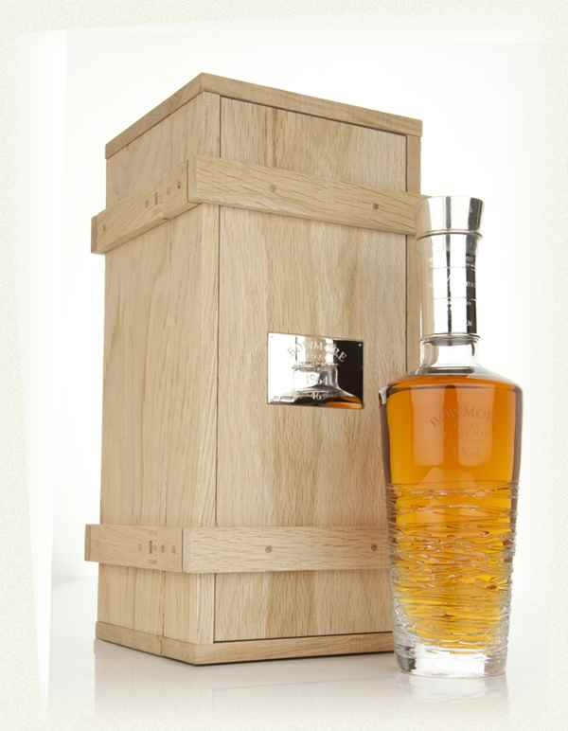
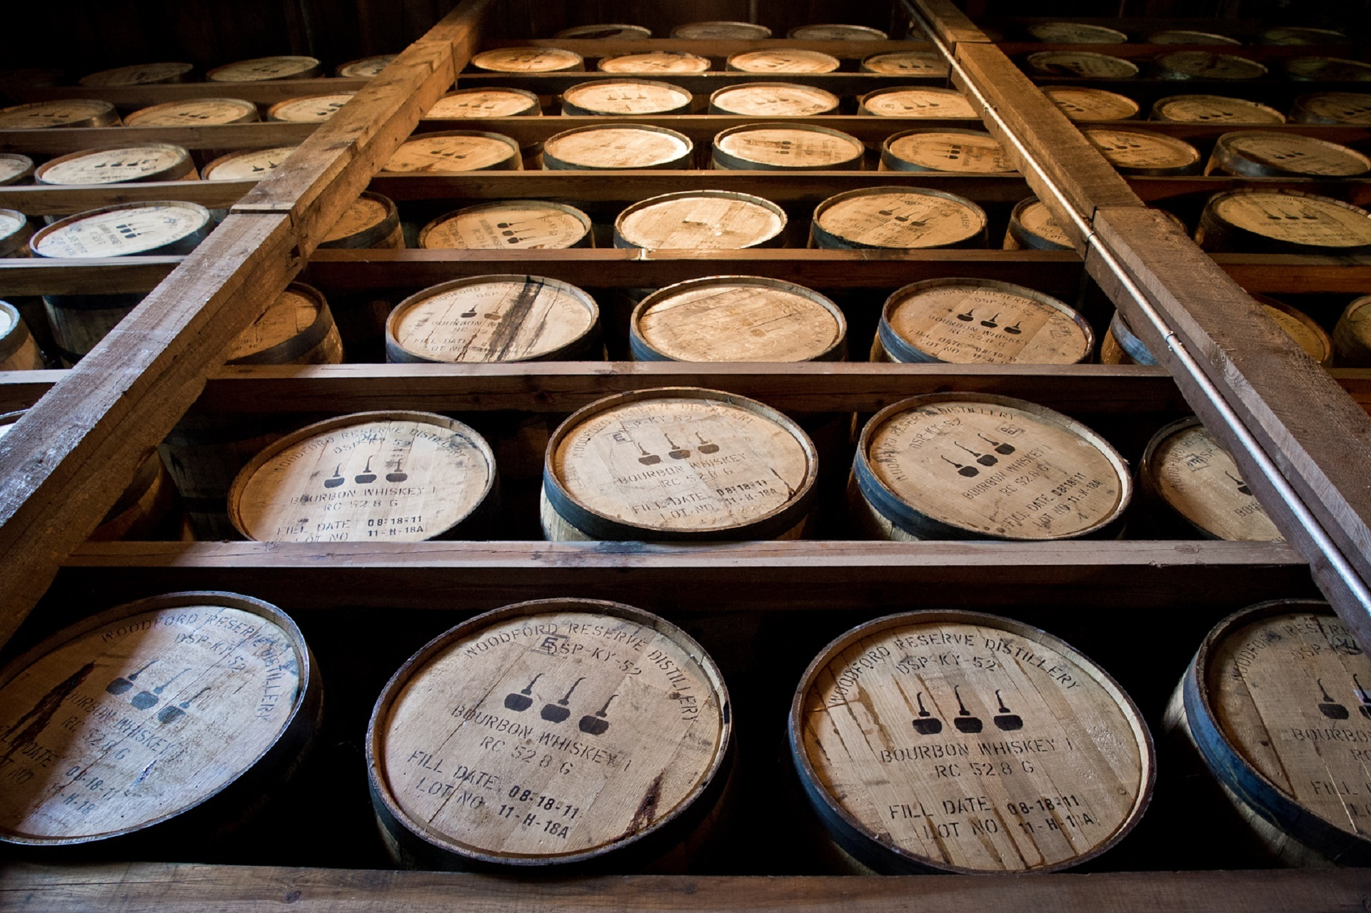
Predicting Top Shelf Whiskeys and Their Prices
IST 736 Text Mining
STEVE ALESSANDRINI
ALEX BALTER
CARLO MENCARELLI
JOHAN WITT

Slide 2
Scotch Whisky Fun Facts
In order to be called Scotch whisky, a whisky must be distilled and matured in Scotland.
A whisky can be called Scotch whisky only after it has matured for a minimum of three years in oak casks in Scotland.
Scotch whisky must be bottled at a minimum strength of 40% ABV i.e. Alcohol by Volume.
There are mainly two types of Scotch whisky – Single Malt Scotch Whisky and Blended Scotch Whisky.
Single Malt Scotch Whisky is made from 100% malted barley and distilled at a single distillery.
Blended Scotch Whisky is made by blending together a number of single malts and grain whiskies.
July 27th is National Scotch Day
Source: https://mobile-cuisine.com/did-you-know/scotch-fun-facts/

Slide 3
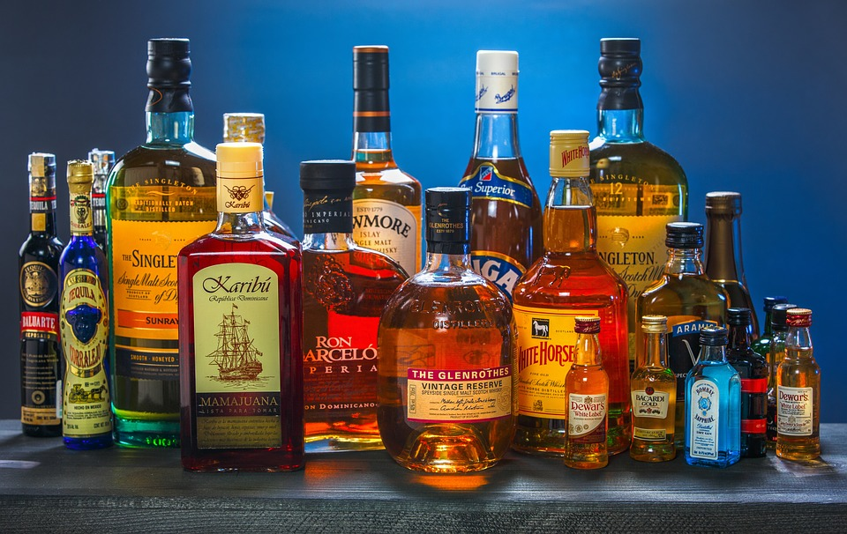

The Dataset
Collected from Kaggle, originally scraped from Whiskey Advocate
Source: http://whiskyadvocate.com/
Data: https://www.kaggle.com/koki25ando/22000-scotch-whisky-reviews
Script: https://github.com/koki25ando/Whisky-Data-Scraping/blob/master/whisky.R
Requires minimal cleaning and transforming
Complete enough to begin analysis immediately

Slide 4
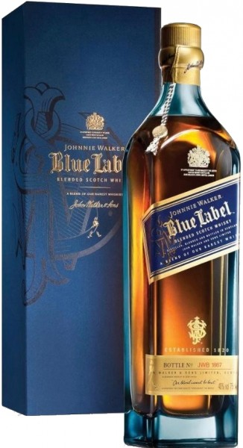
The Data
Contains 2,247 rows, 6 features
Name of Scotch
Some names have distilled year and ABV
Category
Blended, Single Malt, Blended Malt, Single Grain, Grain.
Review Score
Min = 63, Max = 97
Price
Mixed, some integers some floats
Currency
All values are set to “$”
Description
Magnificently powerful and intense. Caramels, dried peats, elegant cigar smoke, seeds scraped from vanilla beans, brand new pencils, peppercorn, coriander seeds, and star anise make for a deeply satisfying nosing ….

Slide 5

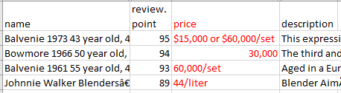
Data Cleaning - Attributes
Initial Cleaning
The Price column within the dataset contained strings, as well as different units of price quantification:
Certain cases were non-numeric and required scrubbing of commas, dollar signs, and other text features.
Some also required “recalculation” such as 60,000/set (chosen to be divided by 4 as the first example suggested).
Cleaning was performed using regular expressions and column was converted to numeric.

Slide 6
Data Cleaning - Text
Additional columns were created as cleaning steps progressed to allow for different options within analysis:
Remove punctuation, numbers and convert to lowercase
Remove stopwords
Original Text
Stem words
“Papier mâché, adhesives, lemongrass, green cardamom, peanut, pear, and other aromatic, fruity characteristics…
...light fruits. £63”
“papier mâché adhesives lemongrass green cardamom peanut pear and other aromatic fruity characteristics…
...light fruits”
“papier mâché adhesives lemongrass green cardamom peanut pear aromatic fruity characteristics…
...light fruits”
“papier mâché adhes lemongrass green cardamom peanut pear aromat fruiti characterist…
...light fruit”

Slide 7
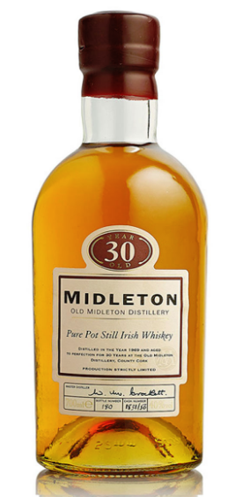
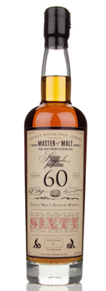
Creating Additional Columns
Year
When available, an age statement could be extracted from “name”.
name
regex
Year
Bowmore 1966 50 year old, 41.5%
'(\d+) years? old'
50
ABV
When available, alcohol by volume could be extracted from “name”.
name
regex
ABV
Bowmore 1966 50 year old, 41.5%
'(\d+\.?\d+?)%'
41.5

Slide 8
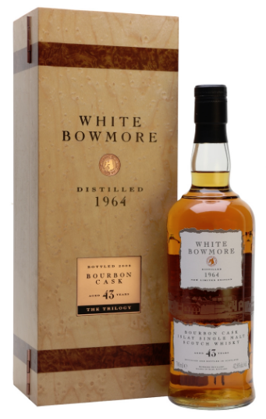
Creating Additional Columns
Vintage and Special Editions
Some bottles were labeled as “vintage” or “X edition”.
name
regex
Vintage_Edition
White Bowmore, 1964 vintage, 43 year old, 42.8%
'[Vv]intage|
[Ee]dition'
TRUE
Johnnie Walker The Casks Edition, 55.8%

Slide 9
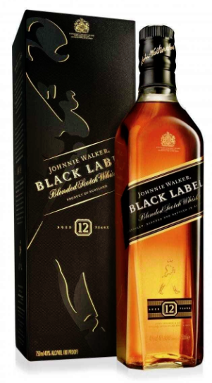
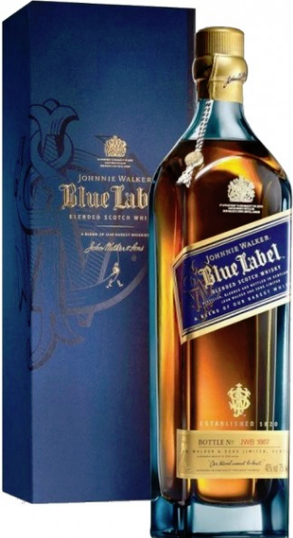
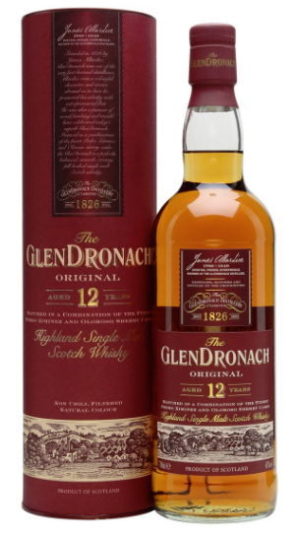
Creating Additional Columns - Brand
Brand
Obtaining “brand” would prove challenging with regular expressions...
Johnnie Walker Blue Label, 40%
Johnnie Walker Double Black, 40%
Johnnie Walker The Spice Road, 40%
Johnnie Walker
GlenDronach, 12 year old, 46%
GlenDronach Sauternes Finish, 46%, 14 year old
GlenDronach 21 year old Parliament, 48%
GlenDronach

Slide 10
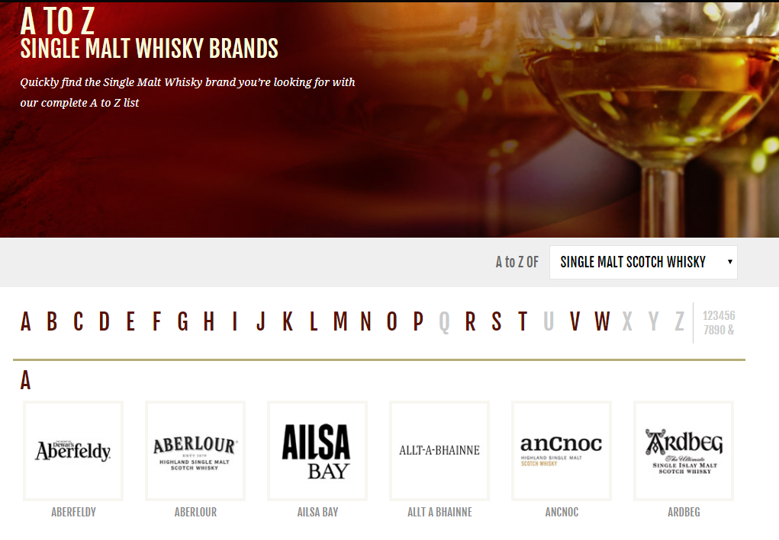
Creating Additional Columns - Brand
A function was made to scrape thewhiskeyexchange.com brand listing website to extract the HTML and use regular expressions to extract brand names.
def extract_brands(website):
url = website
response = requests.get(url)
soup = BeautifulSoup(response.text, "html.parser")
soup_str = str(soup)
scotches = re.findall('<spanclass="az-item-name">([A-Za-z\s\']+)</span>', soup_str)
scotches = [x.lstrip().rstrip() for x in scotches]
return(scotches)
https://www.thewhiskyexchange.com/brands/scotchwhisky/40/single-malt-scotch-whisky.html

Slide 11
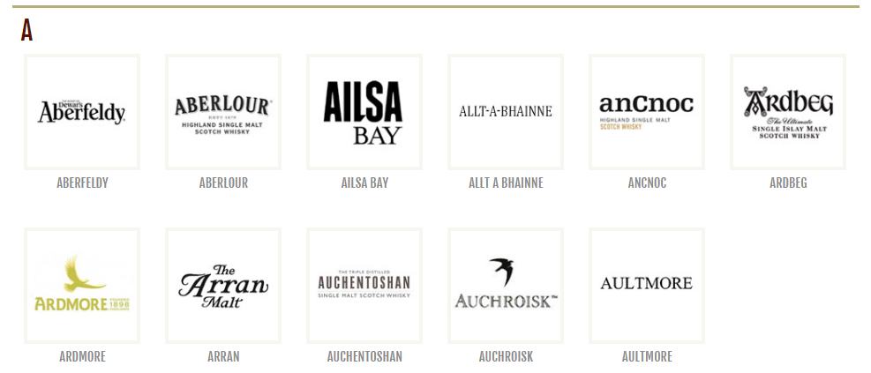
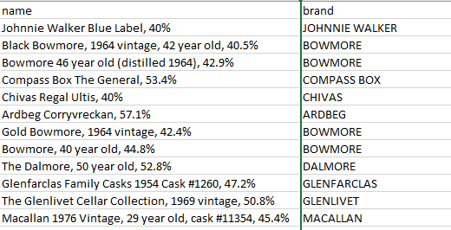
Creating Additional Columns - Brand
Single Malt List
['Aberfeldy', 'Aberlour', 'Ailsa Bay', 'Allt A Bhainne', 'AnCnoc', 'Ardbeg', 'Ardmore', 'Arran', 'Auchentoshan', 'Auchroisk',...]
Extract all brands from websites.
Create large regular expression to extract matching brands from name column.

Slide 12
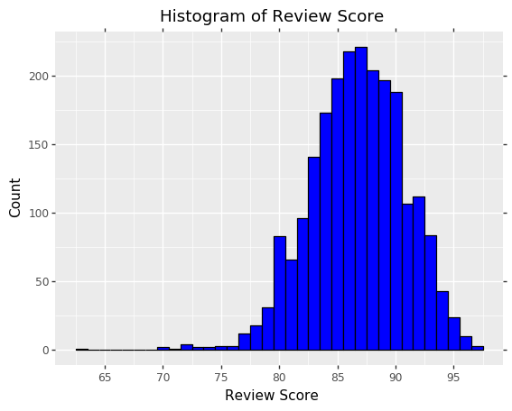
Creating Additional Columns
Review_Score_Class
Using the 25th and 75th percentiles to split “review.point”, the reviews were given a class label of “Below Average”, “Average” and “Above Average”.
25th percentile = 84
75th percentile = 90
< 84
Bet. 84 and 90
>= 90
Class
Below Avg.
Average
Above Avg.
Count
465
1211
571

Slide 13
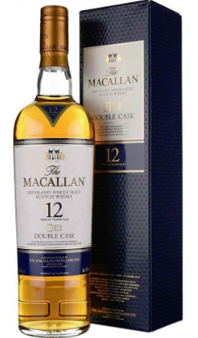
Additional Columns - Quick Stats
53.5% of rows had a year statement.
99.3% of rows had an ABV %
19% of rows were listed as “Vintage” or “Edition”
91.5% of rows were able to have brand extracted

Slide 14
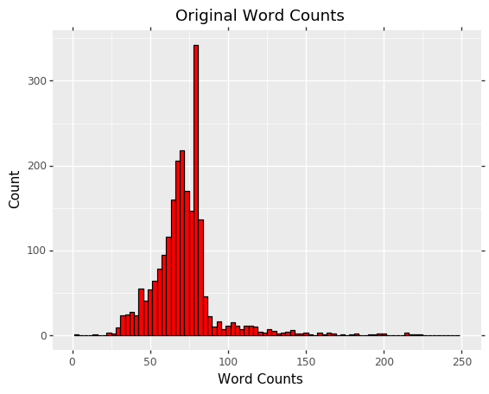
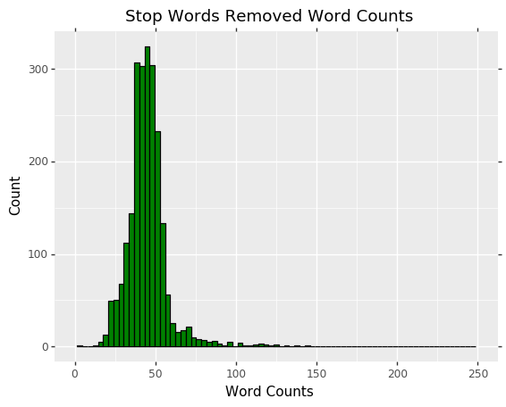
Additional Columns - Quick Stats
Distribution of Word Counts
Cleaning

Slide 15
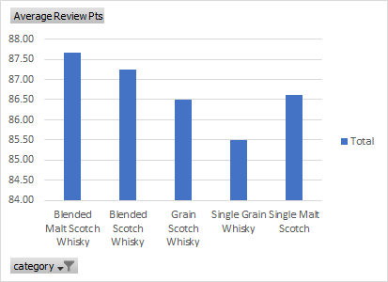
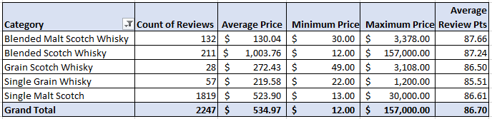
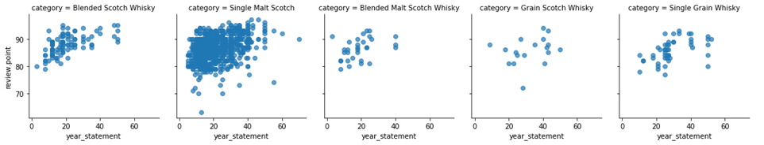
Descriptive Analysis - High Level Numbers

Slide 16
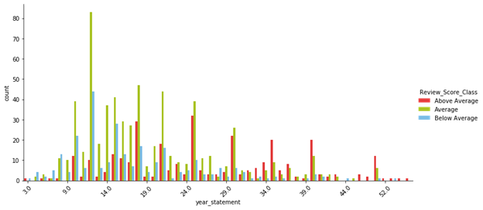
Descriptive Analysis - Age Factor in Reviews

Slide 17
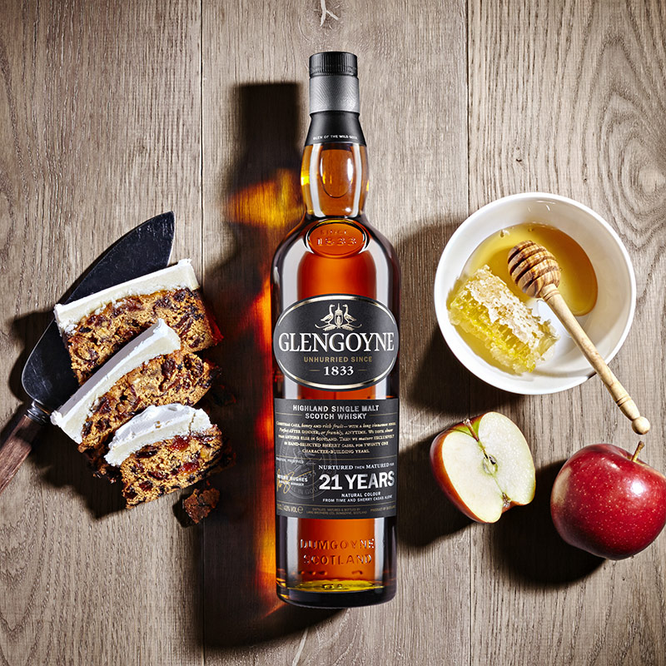
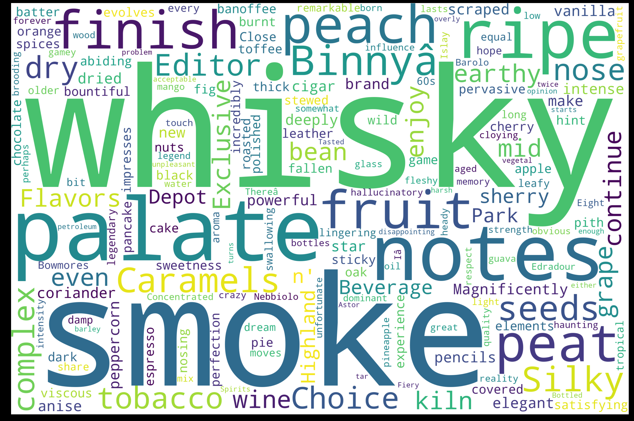
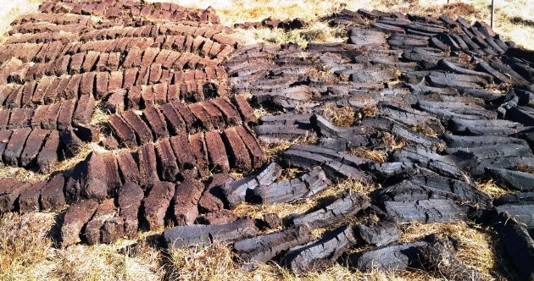
Descriptive Analysis - Overall Word Cloud

Slide 18
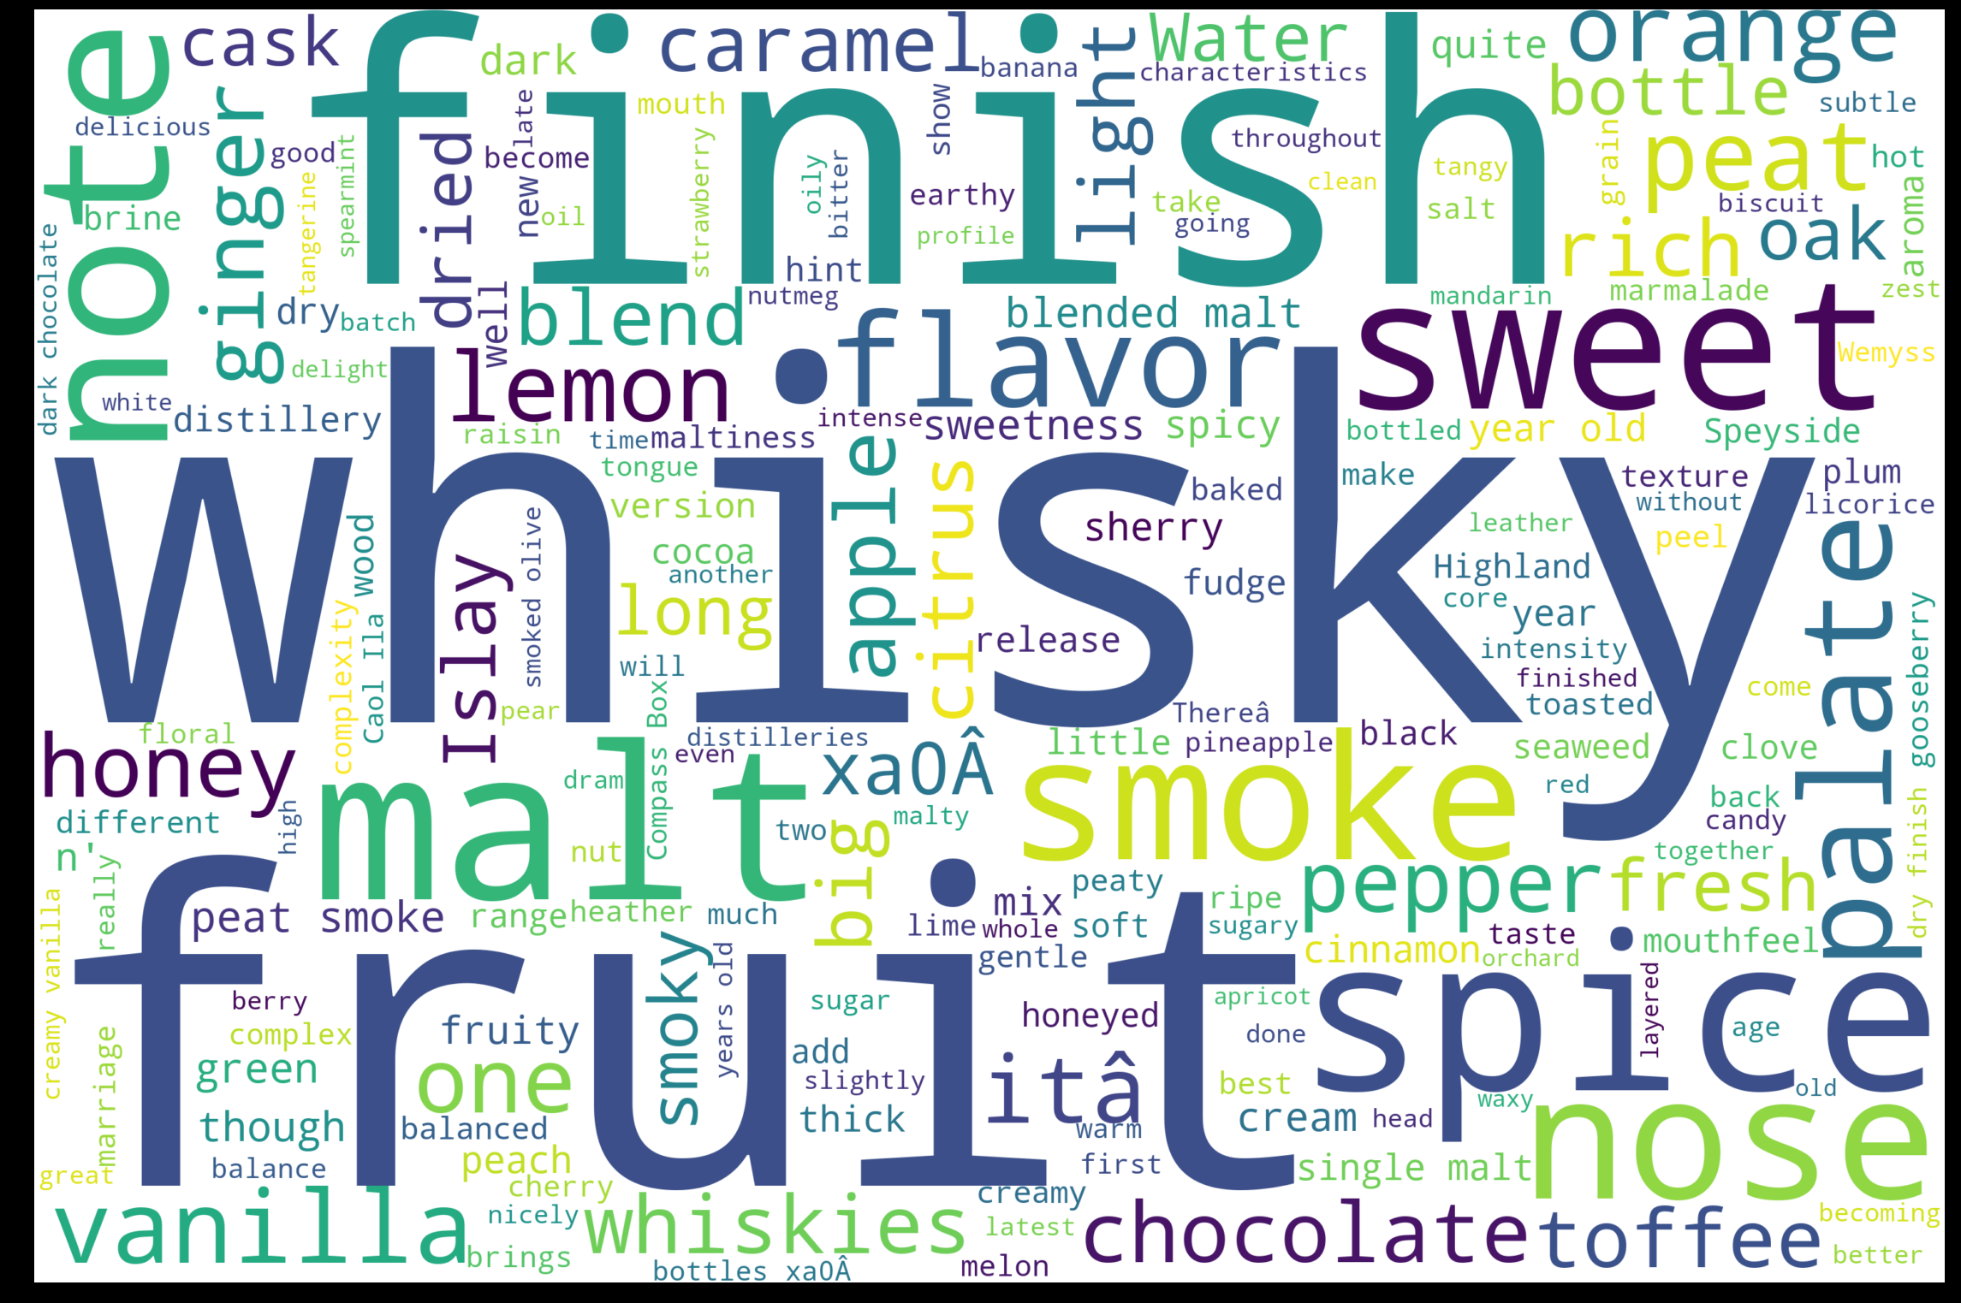
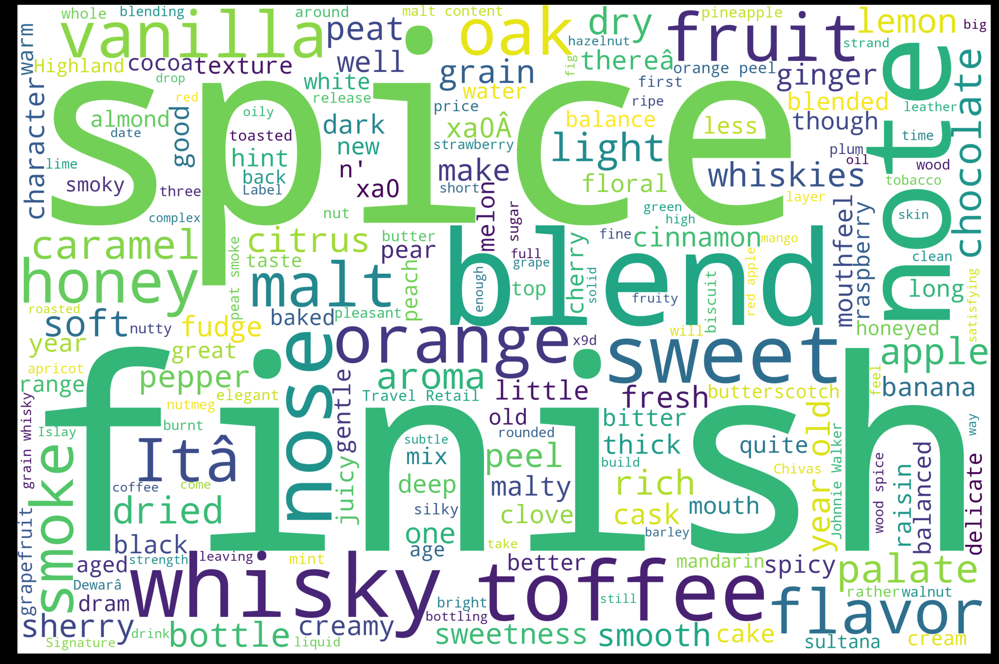
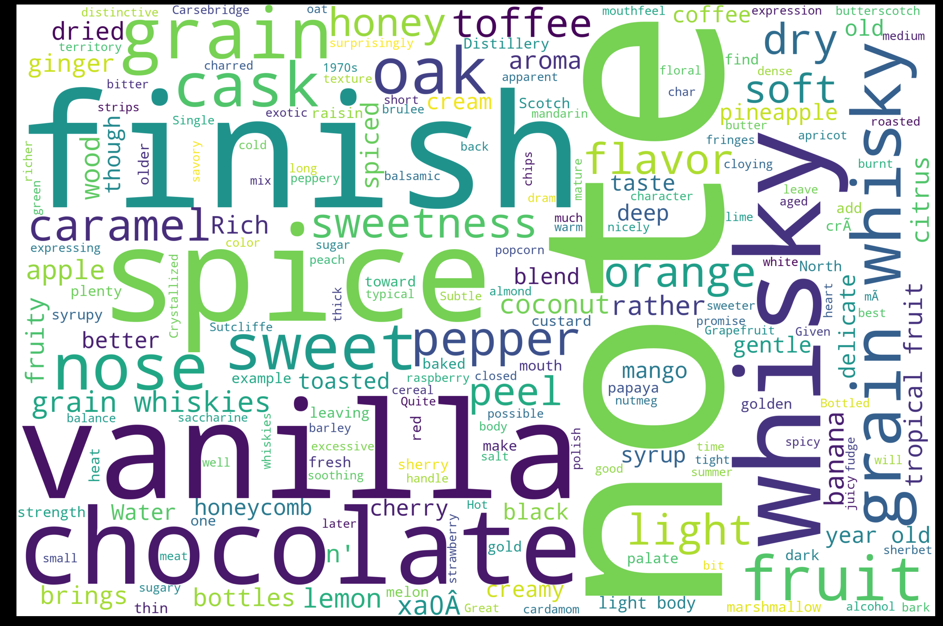
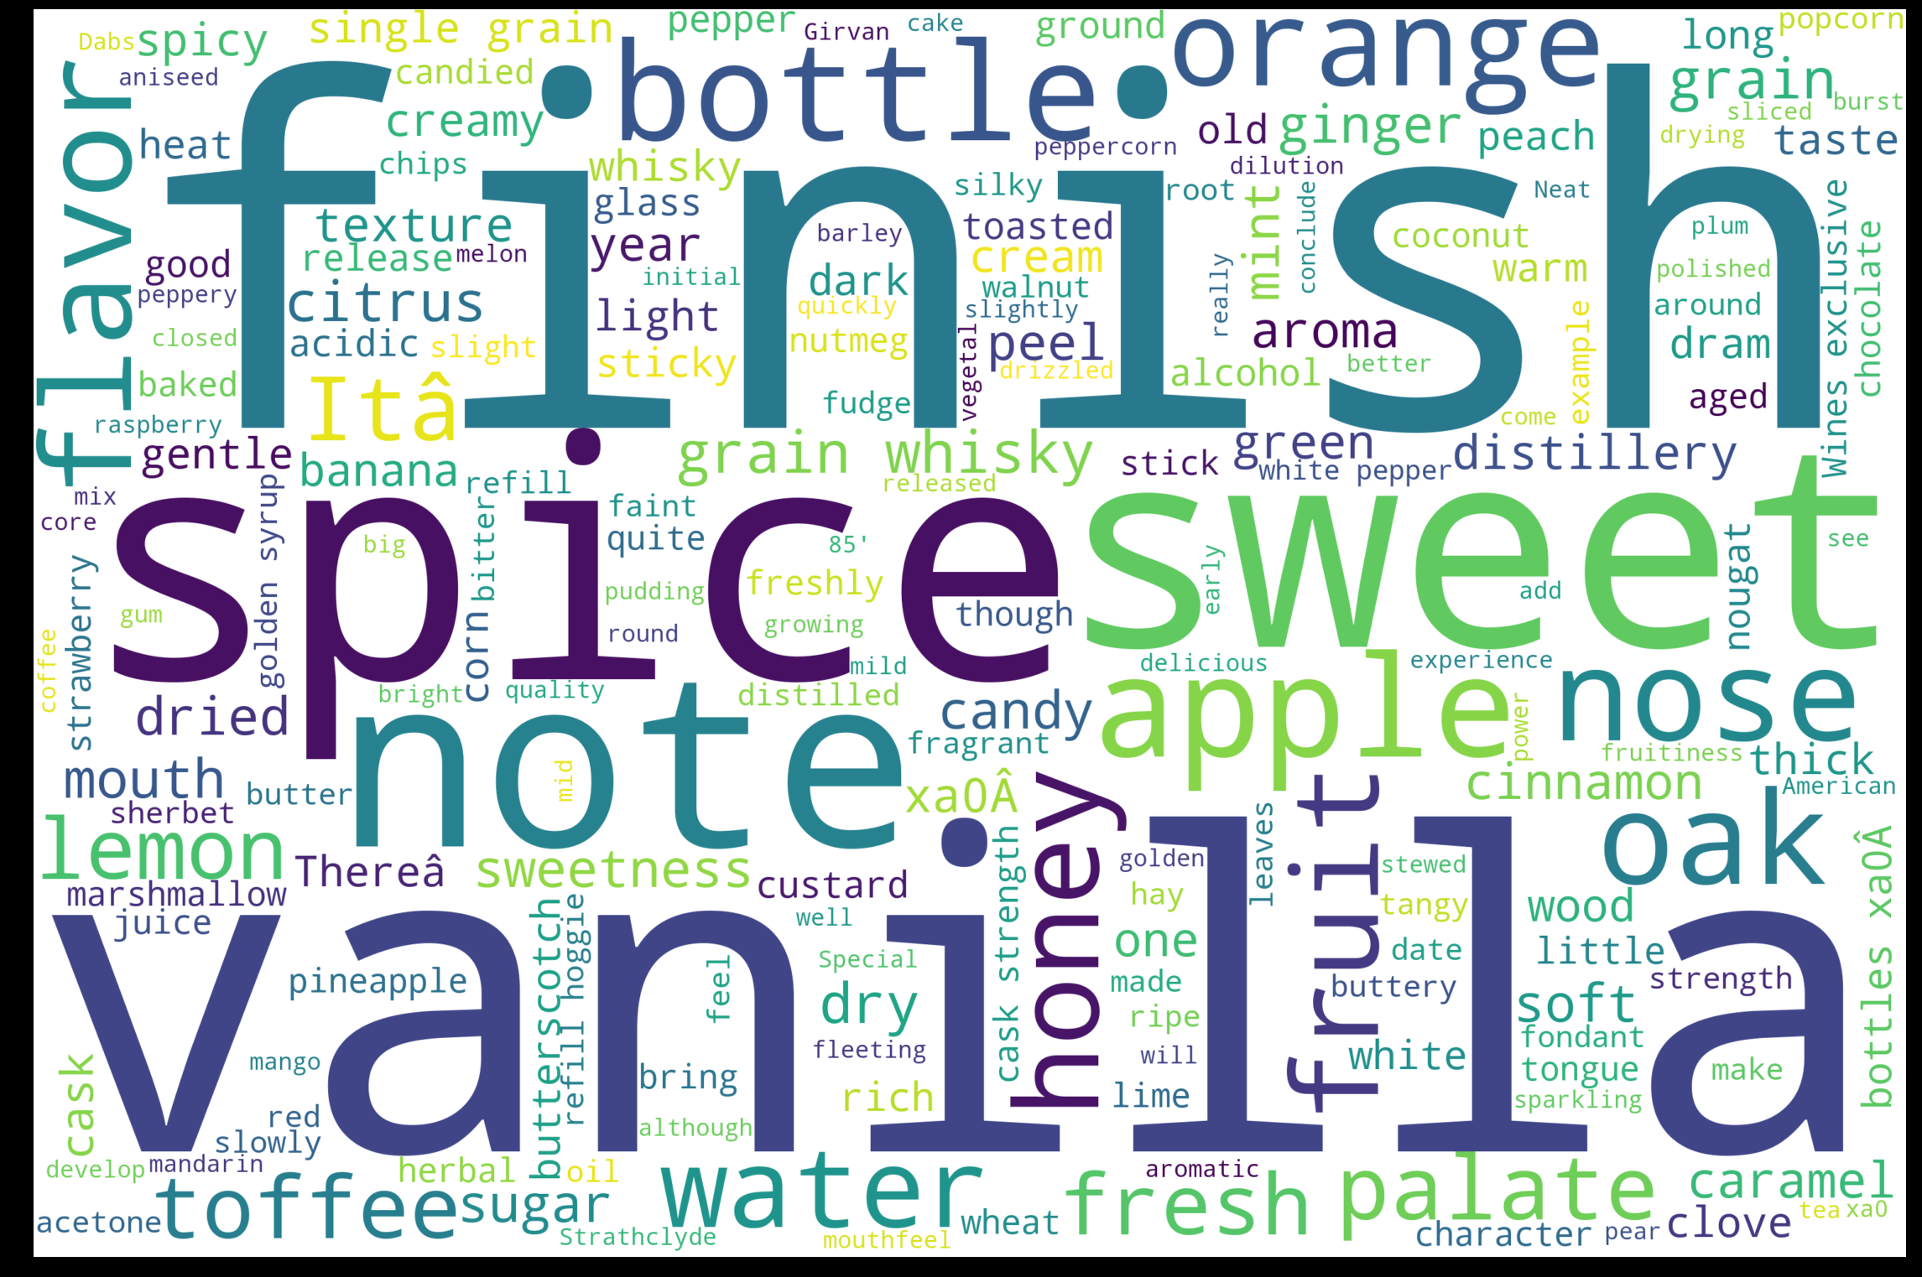
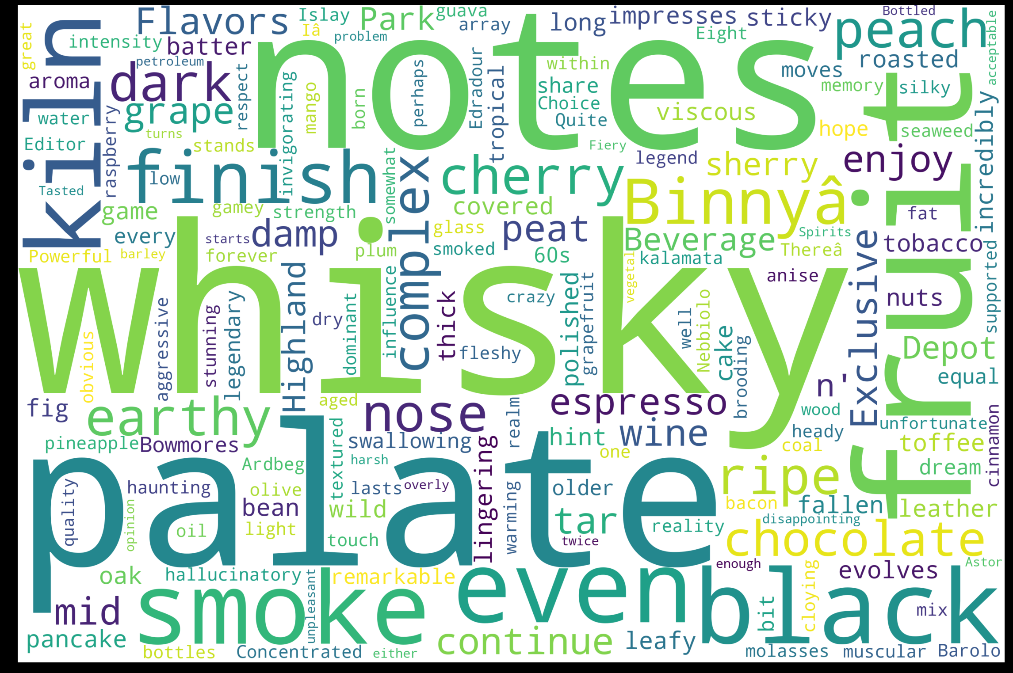
Descriptive Analysis - Category Word Clouds
Blended Malt Scotch Whisky
Blended Scotch Whisky
Grain Scotch Whisky
Single Grain Whisky
Single Malt Scotch

Slide 19
Predictive Modeling Methods
Used a 10/90 test-train split
Trained and fitted against both sentiment and price
Unless specified otherwise, settings were set at defaults
Generated confusion matrices to verify true and false predictions
Calculated Cohen’s Kappa score for a more robust accuracy
Primarily used Sci-Kit Learn, Gensim, and NLTK packages
Data
Test/Train
Split
Preprocessing
Fit
Predict
Report

Slide 20
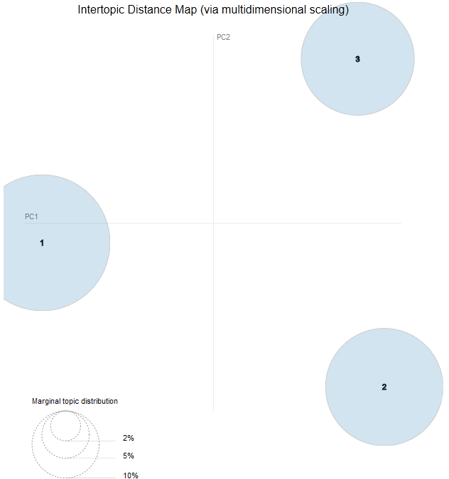
Predictive Topic Modeling
Using LDA to discover any potential topics in the review corpora
Looked at 2, 3, and 5 topic splits
3 topics provided the best split with no overlap
With 2 topics, these ideas surface:
Taste specific reviews
Appearance specific reviews
With 3 topics, the main ideas appear to be:
Fruits (Orange, Plum, Cherry)
The Glenlivit brand
Other tastes (Honey, Vanilla, Dessert)

Slide 21
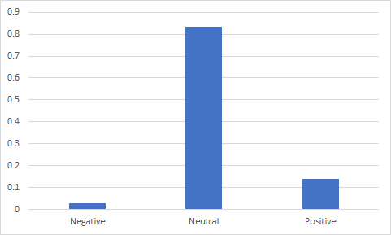
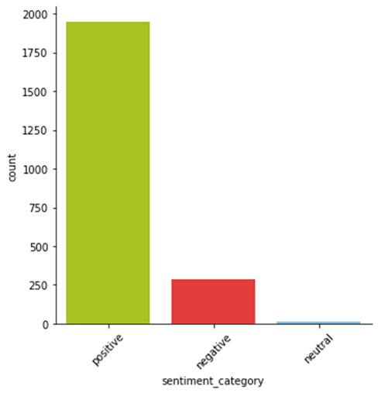
Sentiment Analysis - Unsupervised
Using the Vader NLTK Package
Full Corpus Review
negative: 0.029,
neutral: 0.833,
positive: 0.138,
Using the Text Blob Package
Full Corpus Review
negative: 0.005
neutral: 0.112,
positive: 0.801,

Slide 22
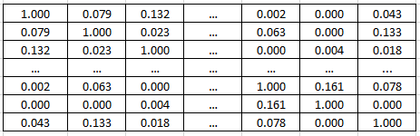
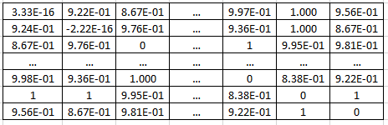
Document Clustering - K-Means
Step 1
Create TF-IDF Document - each document is normalized to length 1, so there is no bias for longer or shorter documents.
This equals taking the relative frequencies instead of the absolute term counts.
This is "TF".
IDF then is a cross-document normalization, that puts less weight on common terms, and more weight on rare terms,
By normalizing (weighting) each word with the inverse in-corpus frequency
This is “IDF”
Step 2
Step 3
K-Means Algorithm
Cosine Similarity Matrix
Top terms per cluster:
Cluster 0: whiski note vanilla dri fruit
Cluster 1: sherri cask finish year old
Cluster 2: sweet water fruit light smoke
Cluster 3: nose cask bottl finish oak
Cluster 4: peat smoke whiski seawe smoki
Euclidean Distance Matrix
How do we categorize these clusters:
0 Vanilla Fruit
1 Sherry Cask
2 Sweet Water
3 Scent and Finish
4 Peat Smoke

Slide 23
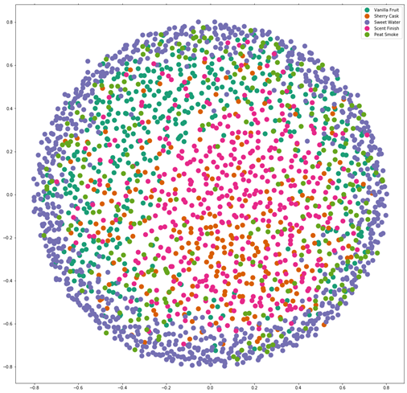
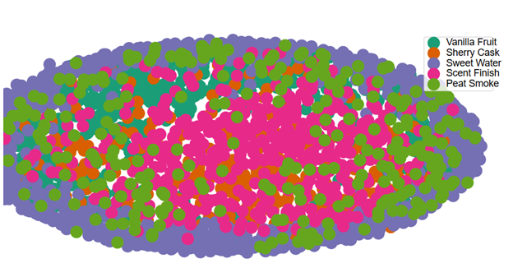
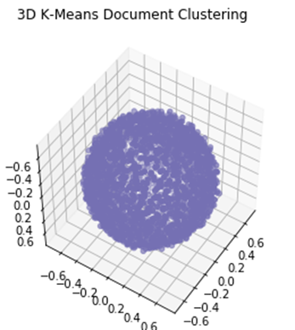
Document Clustering - K-Means
Document Cluster Predictions
Entry 1
marriag three differ singl malt age american french oak whiski show advantag marri whiski one distilleri proper done vibrant complex array fruit orchard fruit sultana sweet light toffe marzipan honey malt spice creami vanilla mocha warm pepper smoke tar smoke oliv coal lesser note toast
Predict - Peat Smoke
Entry 2
Aromatic sherri flavors are good
Predict - Sherry Cask

Slide 24
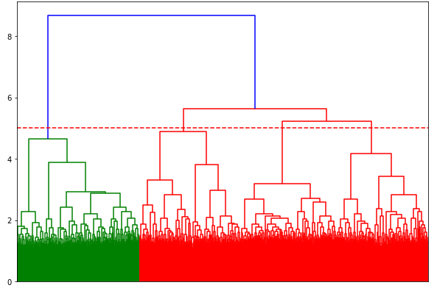
Document Clustering - Hierarchical
Step 1
Ward's method is a criterion applied in hierarchical cluster analysis. Ward suggested a general agglomerative hierarchical clustering procedure, where the criterion for choosing the pair of clusters to merge at each step is based on the optimal value of an objective function.
The algorithm starts at the bottom and calculates the merged distances This objective function could be "any function that reflects the investigator's purpose."
A dendrogram is created to show the merges of related documents.
Step 2
The number of document clusters is the obtained by selecting the number of clusters on the longest vertical line prior to when the vertical line crosses the horizontal line.
Therefore, our selection is 4 document clusters which actually lines up with our K-means selection
Dendrogram

Slide 25
Modeling Techniques Used
Collected and classified data using traditional descriptive statistics:
Means, medians, percentiles
Data distributions (histograms)
Trained models using these algorithms
Support Vector Classifier
Bernoulli Naive Bayes
Multinomial Naive Bayes
Decision Trees
Latent Dirichlet Allocation
Document Clustering

Slide 26
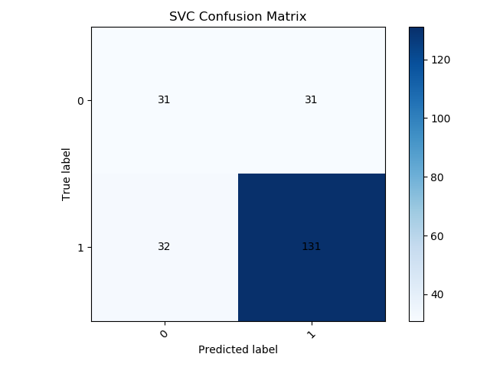
Models - Support Vector Machine
With a linear SVM Classifier, high levels of accuracy were attained for sentiment and price
When using the Kappa score, it’s clear that there is a large element in luck in the prediction
Penalty term (C) was set to 10 (compared to the default of 1
Price
Accuracy: 72.0%
Kappa: 35.99%
Sentiment
Accuracy: 62.67%
Kappa: 30.35%
Confusion Matrix for Price Prediction

Slide 27
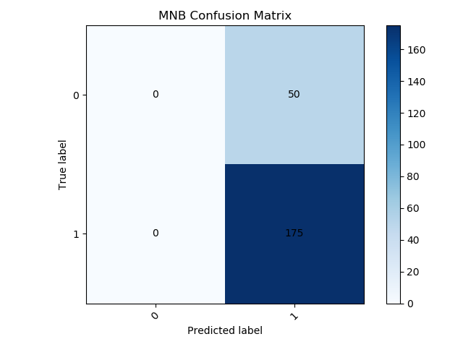
Models - Multinomial Naive Bayes
A Multinomial Naive Bayes returned moderate results
The Kappa coefficient for sentiment is 0 which indicates no agreement between the actual and predicted values
This CM is shown to the right
This could indicate an error in the model or preprocessing
Price
Accuracy: 90.45%
Kappa: 33.35%
Sentiment
Accuracy: 72.4%
Kappa: 0%
Confusion Matrix for Sentiment Prediction

Slide 28
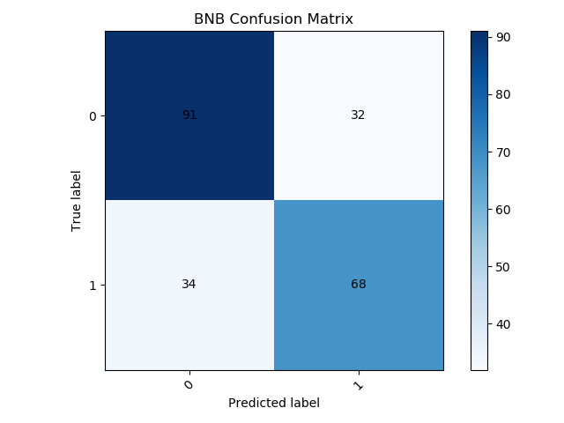
Models - Bernoulli Naive Bayes
A Bernoulli Naive Bayes returned the best (and most realistic) results of those tested
High price accuracy and kappa coefficient
High sentiment accuracy and the highest kappa coefficient of the models
Price
Accuracy: 70.67%
Kappa: 40.72%
Sentiment
Accuracy: 87.59%
Kappa: 32.36%
Confusion Matrix for Price Prediction

Slide 29
Models - Decision Tree
A basic decision tree classifier was trained
Similar to the SVC model, there are some issues preventing accurate classification for both sets of data
Price
Accuracy: 70.67%
Kappa: 3.18%
Sentiment
Accuracy: 44.44%
Kappa: 17.32%
Confusion Matrix for Price Prediction

Slide 30
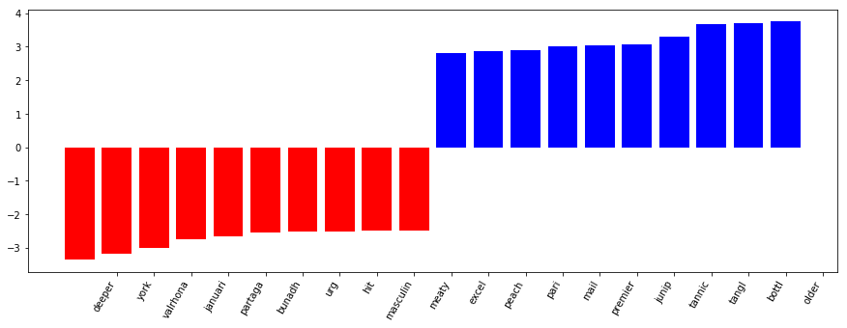
Most Important Words

Slide 31
Conclusions
There is a large amount of subjectivity in the reviews.
A Model can be made to predict the score of a review based on the sentiment of the review
Based on the most impactful words, it appears that lower scores come from more critical reviewers and positive reviews come from more casual reviewers.
The document clustering brought to light common focus areas of the reviews that were also apparent in the Word Cloud. Items such as finish, scent, smoke, and fruit were shared and drivers of sentiment.
LDA Topic analysis shows the different points of emphasis for each reviewer.

Slide 32
Questions?

